Slide 1
TDA PROJECT 1
Presented By:
SHANE PUTNEY,
KEVIN URURE CRUZ,
ENZO RODRIGUEZ,
PRATIK,
SAKSHI SOLANKI,
SRI NIKHIL SURAPANENI

Slide 2
Introduction
Objective:
To build a successful training model to predict letters from the Latin alphabet through the process of persistent homology.
Key Concepts used:
Persistent homology, Bottleneck distance, Agglomerative clustering, Multinomial logistic regression.

Slide 3
Procedure:
A dataset is created by reading 10x10 pixel images for each letter of the Latin Alphabet, where the pixel values are 0 if there is no part of the letter and 1 otherwise.
Using Lower Star Image Filtrations from ripser.py, combined with different scanning methods, 0- Dimensional class in each letter is obtained to classify them through Euclidean distance.

Slide 4
Once we obtained the persistent homology for each letter, we will calculate the pairwise bottleneck distance.
Agglomerative clustering method is applied to the pairwise distances to grab values for the classification test.
Finally , we create a design matrix with the values obtained from the agglomerative clustering method and run a simple normal multinomial regression.
Once we have obtained 100% classification on each letter, testing can be done by changing certain pixel values from 0 to 1 or vice versa .

Slide 5
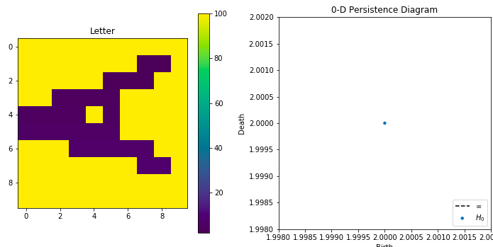
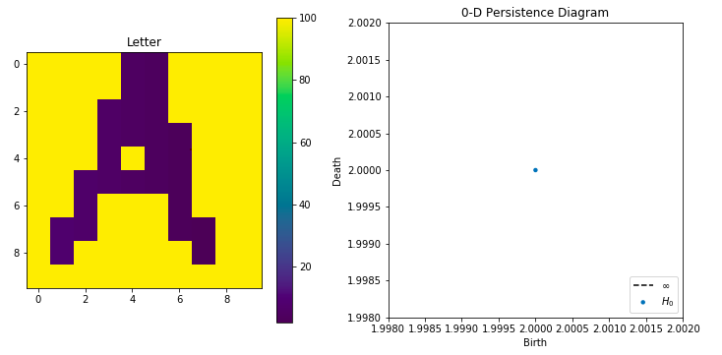
Types of Scans
Originally we had multiple scans in order to properly classify each letter.
Scanning methods: Top-to-bottom, Bottom-to-top, Left-to-right, Right-to-left, Probing and angle scanning from upper left corner and the bottom right corner.
Transposed the matrices of each vector in order to rotate the images and perform different scanning methods using the original formula.
Looping through each letter to find unique birth and death rates also known as betti numbers, in the 0-dimensional space.

Slide 6
Algorithm
Develop Persistent Diagram Matrices
Convert Persistent Diagram Matrices to a Useable Feature
Predict the Letters Using these Features

Slide 7
Converting Persistent Diagram to Useable Features
Develop a pairwise bottleneck distance matrix between all letters for each filtration
Use an agglomerative clustering method on the distance matrix to find hidden labels
The vector of hidden labels assigned to each letter is a single input feature

Slide 8
Additional Features
Used Left to Right, Right to Left, Angle Probing, and Diagonal Filtrations
Accompanied these four filtrations with a few location-based density features
Testing the density of the whole letter, the density of the top half, the density of the right half, the density of the bottom half, and the density of the bottom right half.

Slide 9
Predict the Letters Using these Features
We trained a multinomial regression model using our new features
The trained model then correctly predicts all 26 letters.

Slide 10
Experiments
Was able to detect slightly sparse letters quite accurately (No errors on the ones I tested)
If letters became too sparse it would not guess correctly
Additionally, although the algorithm runs relatively fast for single letter predictions, the re-development of a pairwise distance matrix is repeated for every case. This could be sped up by using a different clustering method where some form of “centers” are calculated. This also prevents drastically sparse letters from developing their own, unique hidden label.

Slide 11
DISCUSSION
Classification was successful on the original 26 letters
Our objective of classification was achieved by using left to right scan, right to left scan, probing from left corner scan, diagonal scan, and 5 density scans.
Only including 4 scans might have not been the best choice
We see that when we introduce noise, our classifier isn't the best.
The classifier would improve if we included the regular persistent homology diagram up to dimension 1, and an L_1 regularization term to our multinomial regression.

Slide 12
LITERATURE REVIEW
English Letter Classification Using Bayesian Decision Theory by Mujtaba Husnain and M. Shahid Naweed (European Journal of Scientific Research Vol.34(No.2):196-202 · July 2009).
Zoning methods for handwritten character recognition by D.Impedovo and G.Pirlo (Journal Pattern Recognition archive Volume 47 Issue 3, March, 2014)
Handwriting prediction based character recognition using recurrent neural network by Shun Nishide, Hiroshi G. Okuno, Tetsuya Ogata and Jun Tani(Proceedings of the IEEE International Conference on Systems, Man and Cybernetics, Anchorage, Alaska, USA, October 9-12, 2011)
Towards Written Text Recognition Based on Handwriting Experiences Using a Recurrent Neural Network by Shun Nishide, Hiroshi G. Okuno, Tetsuya Ogata and Jun Tani( Advanced Robotics 25(17):2173-2187 · January 2011 )

